Slide 1

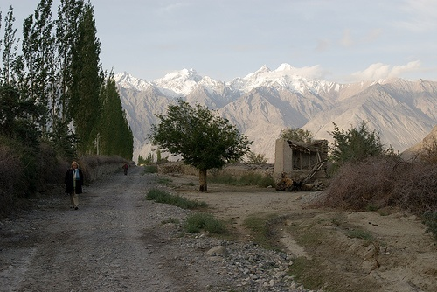
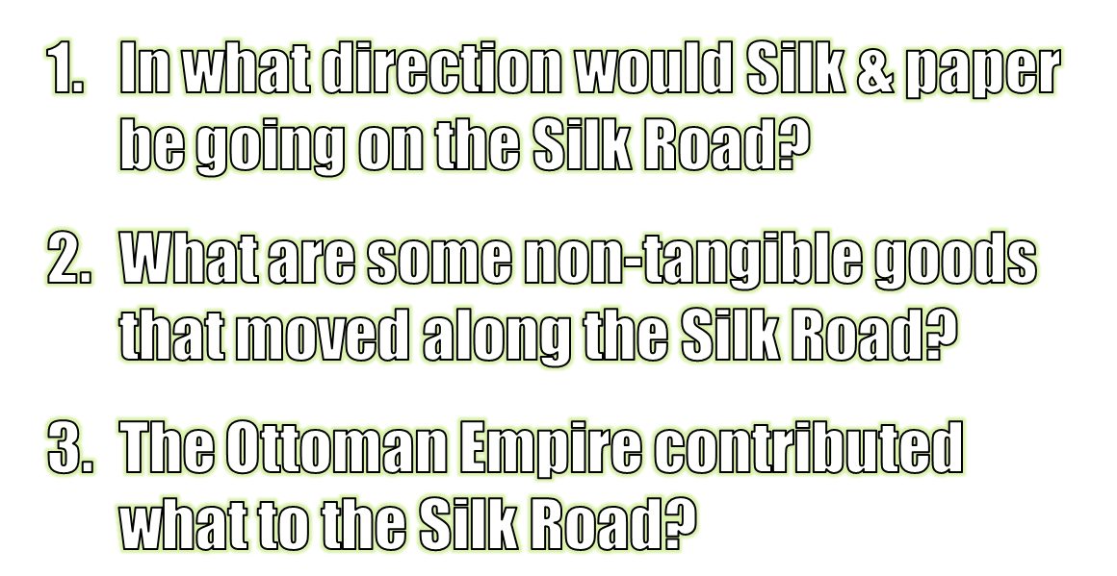
Goods & Advancements moved along the Silk Road
• Paper, compass, silk, porcelain from China
• numeral system from the Middle East
• Scientific knowledge—medicine, astronomy, mathematics

Slide 2


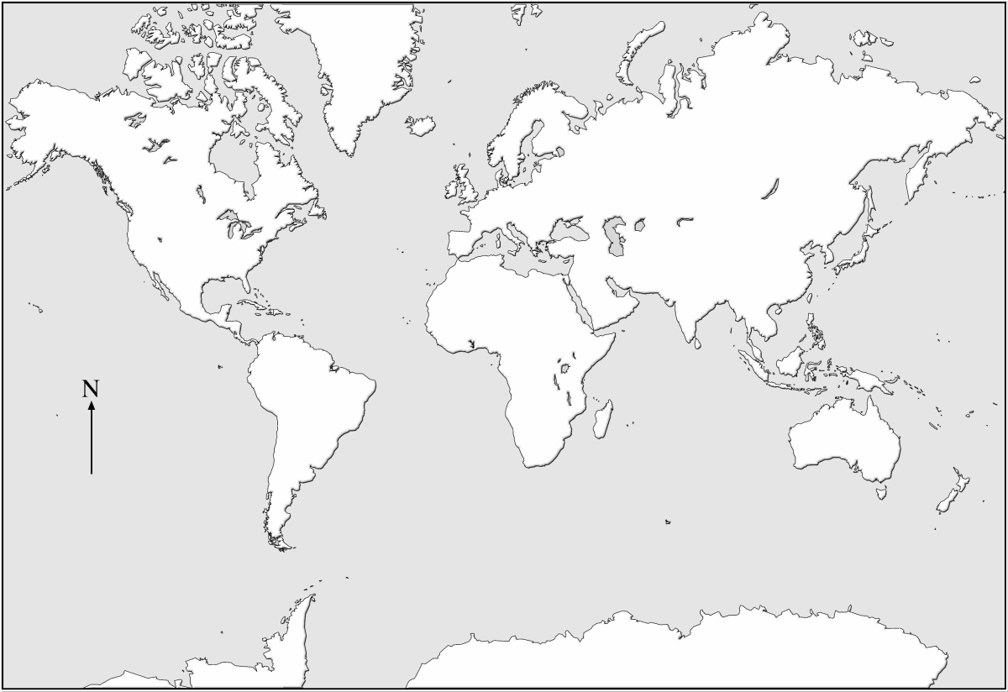
© Students of History - http://www.teacherspayteachers.com/Store/Students-Of-History

Slide 3
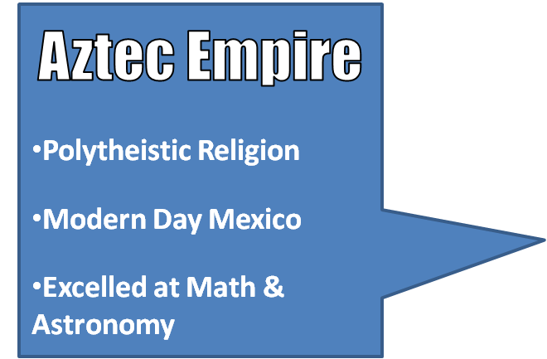
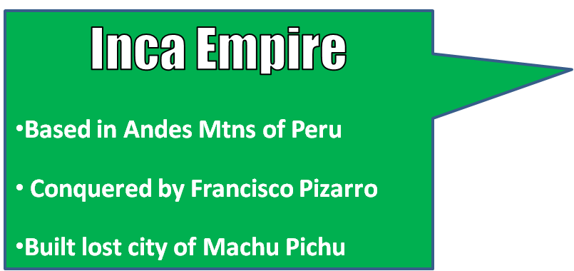
Europe
England – Great naval power
France – Always warring with England
Russia- Large but poor and very little technology

Slide 4

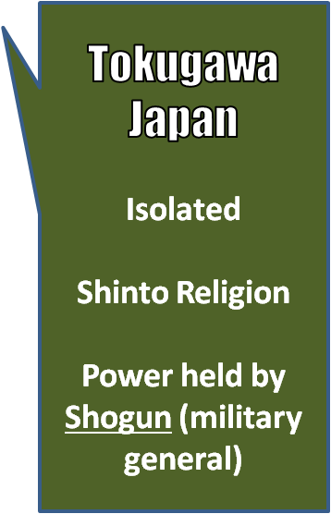
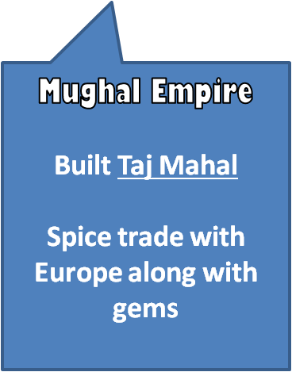
Ming China
Trade along silk road
Build Great Wall for protection
Develop 1st paper and paper money
Foreign trade allowed only in enclaves
Europe
England – Great naval power
France – Always warring with England
Russia- Large but poor and very little technology
Ottoman Empire
Capital is Istanbul
Trade coffee, ceramics,
United by Islam religion
Silk Road
Trans-Sahara Trade Route
Songhai Empire
Last of 3 North African Empires
Controlled Gold-Salt Trade with Europe & Ottomans

Slide 5

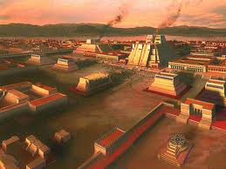
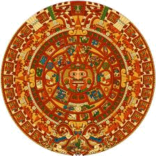
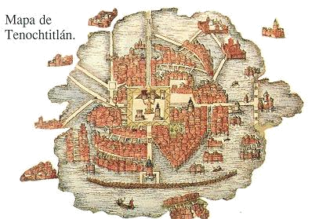
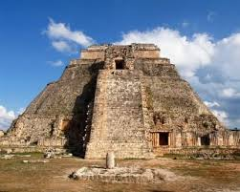

Slide 6

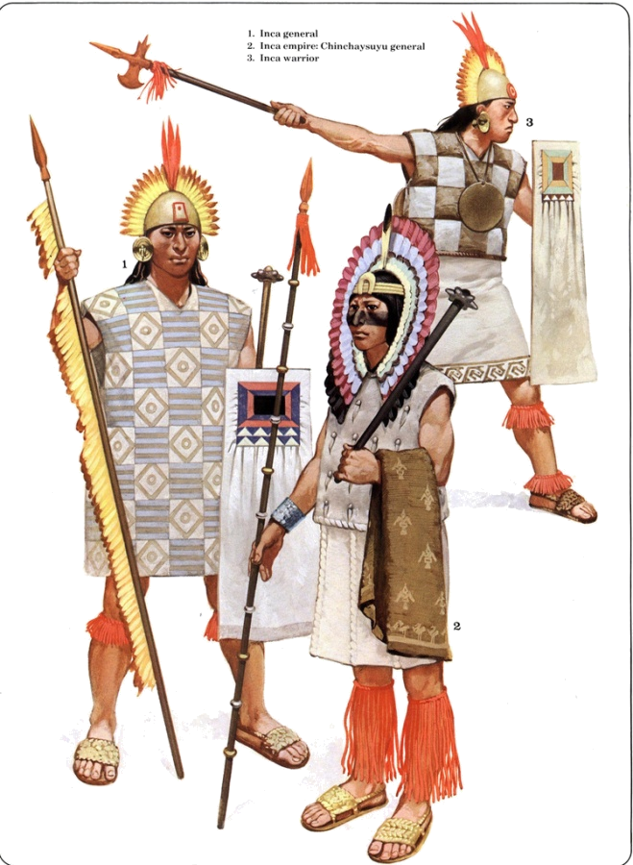
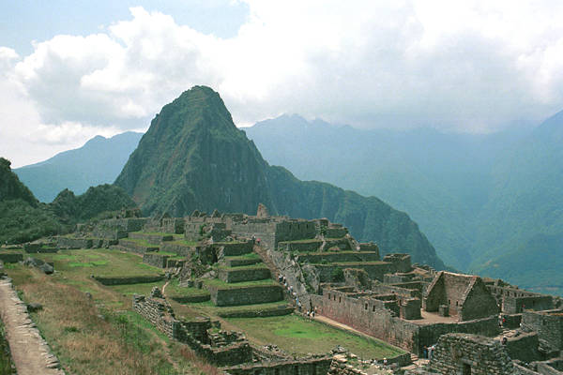
© Students of History - http://www.teacherspayteachers.com/Store/Students-Of-History

Slide 7

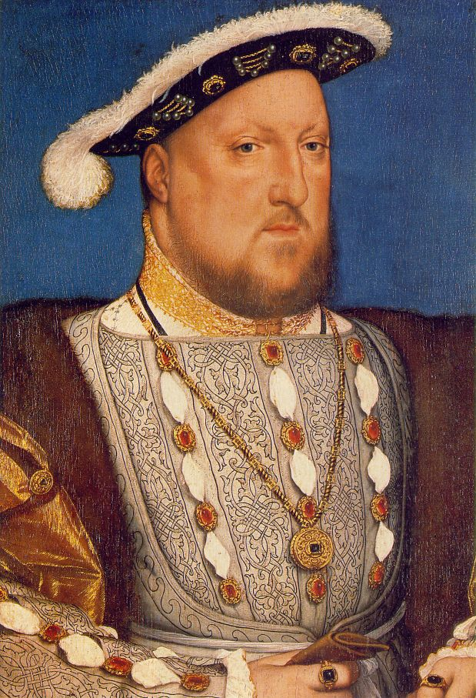
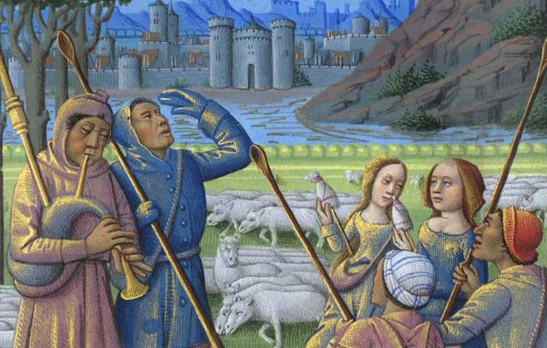

Slide 8

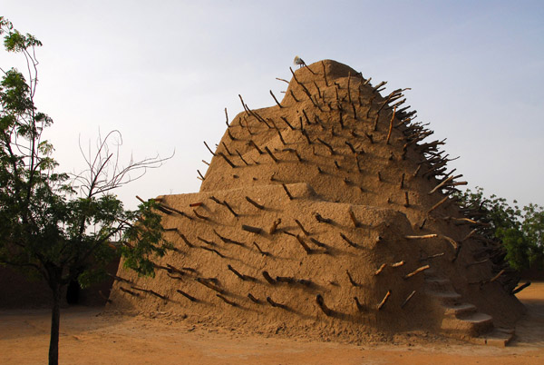
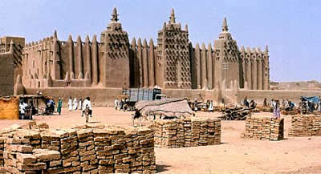
© Students of History - http://www.teacherspayteachers.com/Store/Students-Of-History

Slide 9

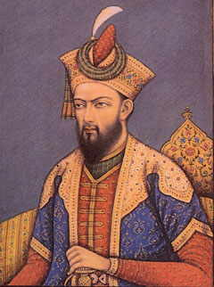
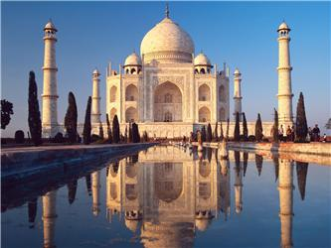
© Students of History - http://www.teacherspayteachers.com/Store/Students-Of-History

Slide 10

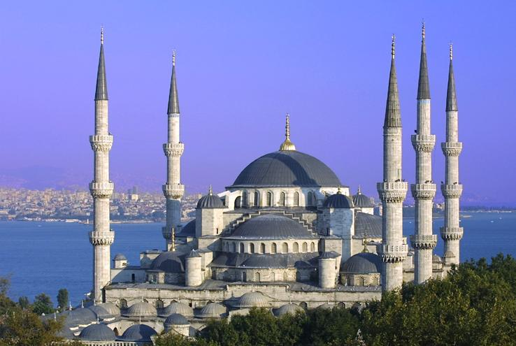
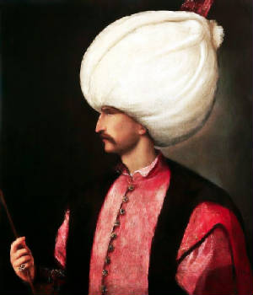
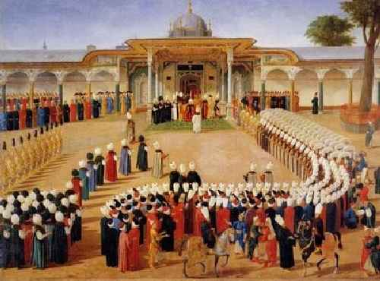

Slide 11

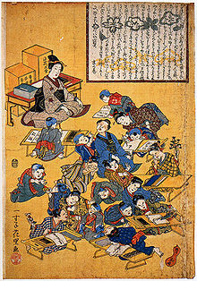
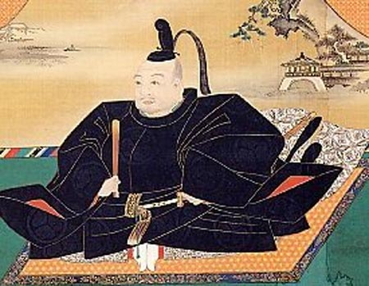
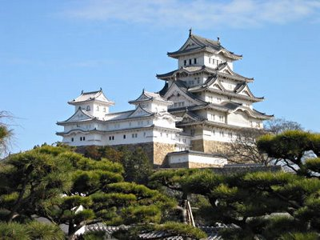
© Students of History - http://www.teacherspayteachers.com/Store/Students-Of-History

Slide 12

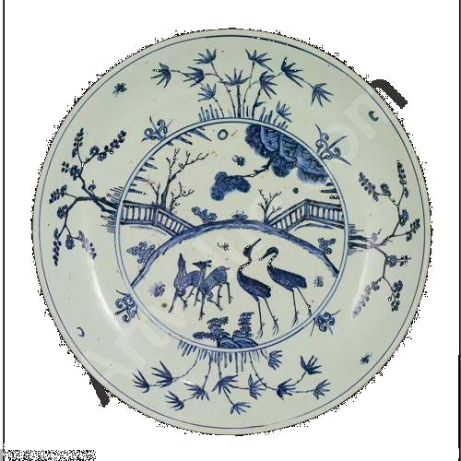
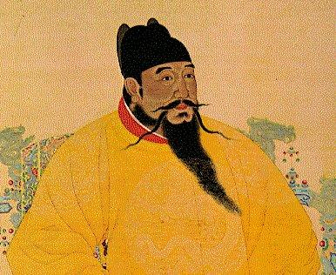
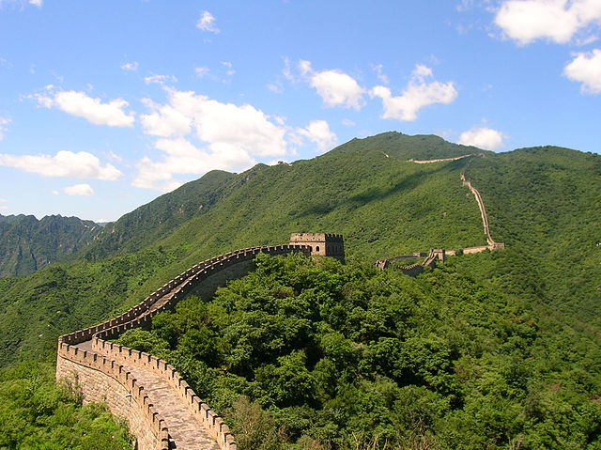
© Students of History - http://www.teacherspayteachers.com/Store/Students-Of-History

Slide 13

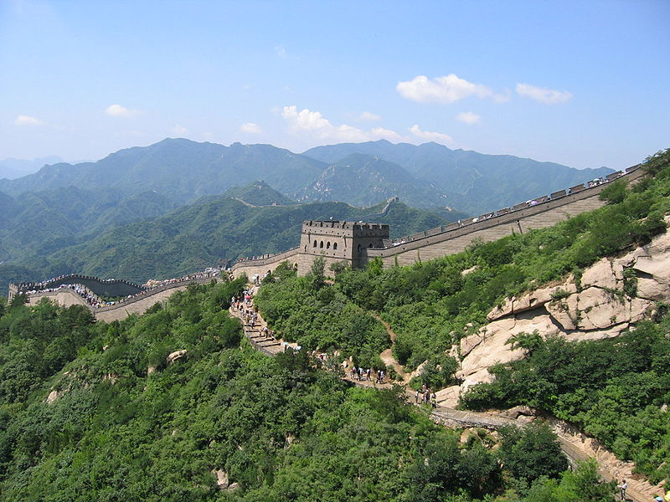
Length of Great wall – 4,160 miles
Distance from NY to California – 3,095 miles
What Dynasty built most of the great wall?
How long do you think it would take to walk across?
If the Great Wall started in NY, how far across America would it stretch?

